Slide 1
UNIT-1
Introduction to Agile Methodologies

Slide 2
Table of Content
What is Agile?
History and Evolution of Agile.
Key Characteristics of Agile
Agile Principles and Values.
Key Roles of the Agile Model.
Agile Ceremonies.
Agile Artifacts.
Software Development Process
Traditional vs. Agile

Slide 3
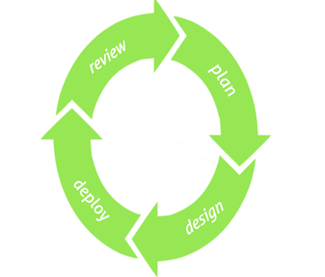
What is Agile?
Agile is a flexible and iterative approach to project management and software development.
It focuses on delivering value incrementally by breaking down work into small, manageable pieces called iterations or sprints.
Agile promotes collaboration, adaptability, and continuous improvement.

Slide 4
History and Evolution of Agile
1950s-1970s:
  Early iterative methods emerged, including Incremental Development in software engineering.
1980s:
  The Spiral Model introduced by Barry Boehm emphasized iterative risk management.
1990s:
  Lightweight methodologies (e.g., Scrum, Extreme Programming) began to replace heavyweight, document-driven approaches like the Waterfall model.
2001:
  The Agile Manifesto was created by 17 software developers, defining Agile principles and values.
Present:
  Agile is now applied across industries beyond software, including manufacturing, healthcare, and education.

Slide 5
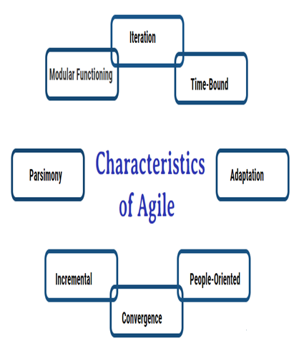
Key Characteristics of Agile
Iterative and Incremental:
  Agile divides work into small
  manageable cycles (sprints) with deliverables at the end of each.
Collaborative:
  Strong focus on teamwork and stakeholder involvement throughout.
Flexible:
  Responds to changes in requirements, even late in development.
Core Goal:
  Deliver value to the customer faster
  while maintaining quality and flexibility.

Slide 6
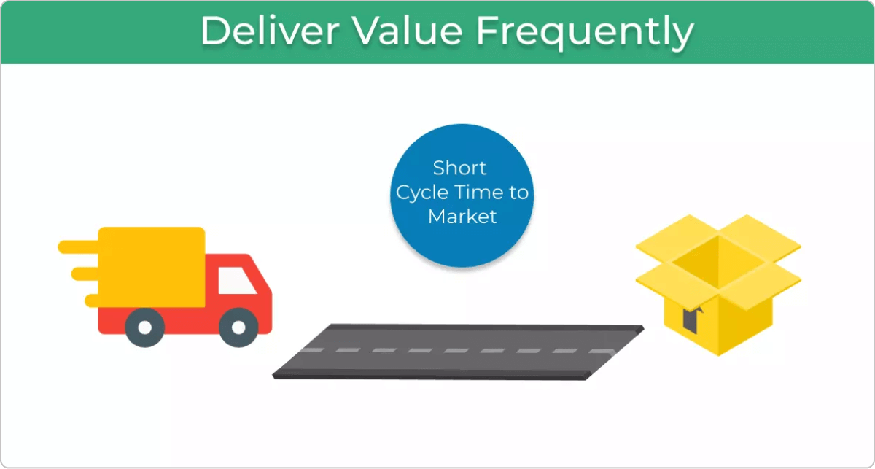
The Agile Principles
Deliver early and continuous value to customers.
Welcome changing requirements, even late in development.
Deliver working software frequently.
Foster collaboration between business and developers.
Build projects around motivated individuals.

Slide 7
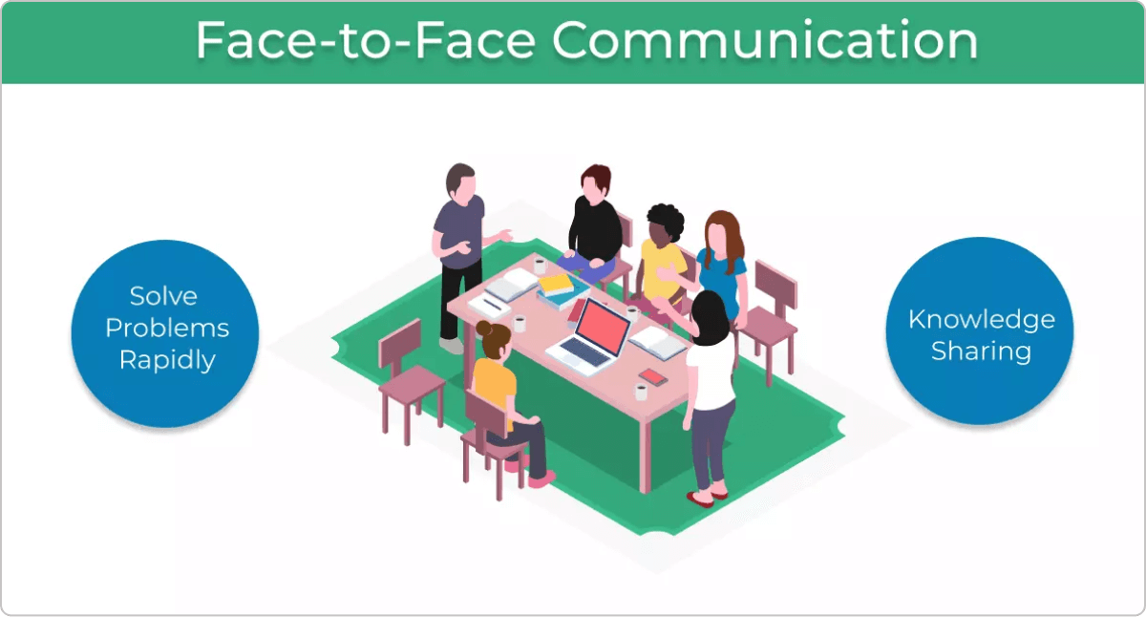
Use face-to-face communication as the most effective method.
Measure progress by working software.
Maintain a sustainable development pace.
Focus on technical excellence and good design.
Maximize simplicity by minimizing unnecessary work.
Empower self-organizing teams.
Reflect and adapt regularly for improvement.

Slide 8
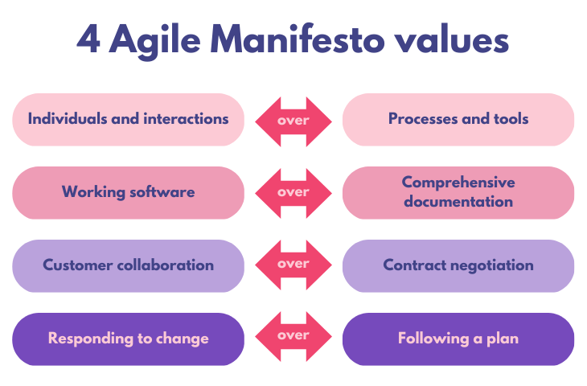

Slide 9
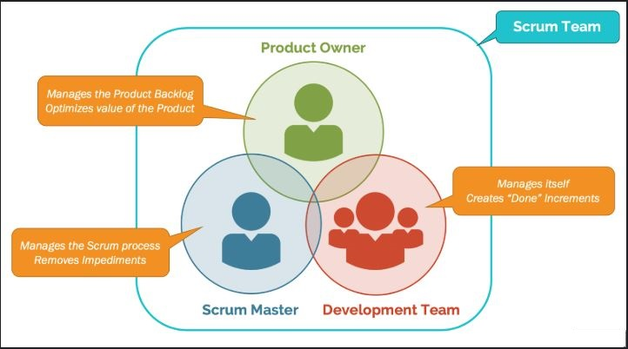
Key Roles in the Agile Model
1.Product Owner
Defines the product vision and priorities.
2.Scrum Master
Facilitates the Agile process and removes roadblocks.
3.Development Team
A cross-functional group responsible for delivering the product increment.

Slide 10
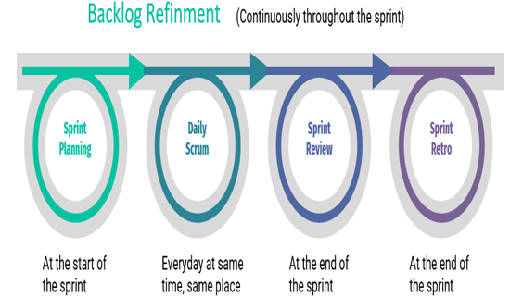
Agile Ceremonies
1.Sprint Planning
Define goals and tasks for the upcoming sprint.
2.Daily Stand-up
Short daily meetings to discuss progress and blockers.
3.Sprint Review
Demonstrate completed work to stakeholders for feedback.
4.Sprint Retrospective
Reflect on the sprint to identify improvements for the next cycle.

Slide 11
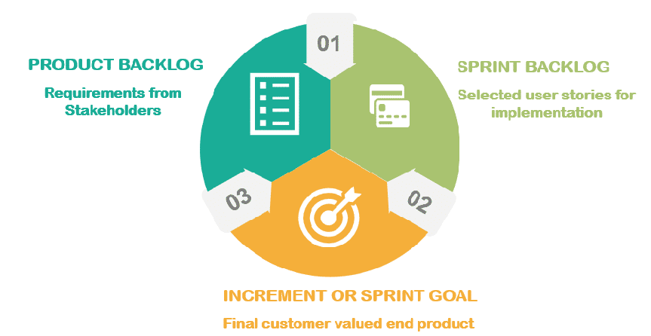
Agile Artifacts
1.Product Backlog
A prioritized list of all desired features and tasks.
2.Sprint Backlog
Selected items from the product backlog for the current sprint.
3.Increment
The working product delivered at the end of a sprint, meeting the Definition of Done.

Slide 12
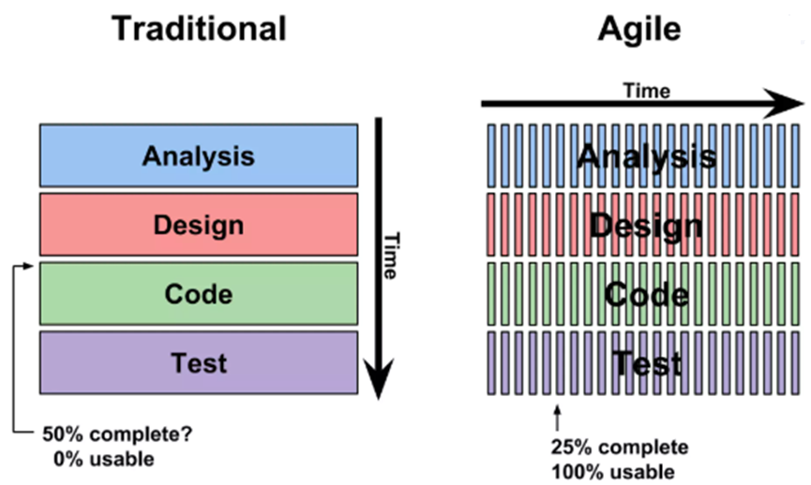
Software Development Process

Slide 13
Traditional vs. Agile Outcomes
Feature/Aspect | Agile Project Management | Traditional Project Management
Approach | Iterative | Linear
Project Phases | Short sprints | Longer phases
Customer Involvement | High, continuous feedback | Low, initial requirements
Team Structure | Cross-functional | Functionally divided
Communication | Face-to-face, informal | Written, formal
Documentation | Minimal | Extensive
Change Management | Easy, welcomed | Difficult, formal approval
Risk Management | Managed continuously | Managed at project milestones
Delivery Time | Faster, incremental | Slower, at project end
Quality Focus | Customer satisfaction | Adherence to requirements

